Slide 1
2022 Summer Internship Reflection
Abhinav Solasa

Slide 2




Pre-Internship Goals
Come in with an open mind
Acquire new technical skills
Exposure to new technologies, methodologies (Agile), and tools
Build my communication skills
Networking
Check out the icon options on the last slide.

Slide 3
My Experience in an Agile Environment
Benefits
Flexible Working
Adaptability
Continuous Improvement
Better Teamwork
Soft Skills
Improvement of communication skills
Task Management (Refinement sessions)
Active Listening
Time Management

Slide 4




Project Objectives
Focus reporting data→ general ledger accounts → transactional data needed to produce income statement, balance sheet, and financial reports
Application responsible for synchronizing ledger account data between accounting database to the company backend database
Frontend Oracle DB → Backend Oracle Db
Deploy this whole process in AWS as a lambda function

Slide 5




Intro slide with four colored circles filled with text
Project Data Migration Flow
Pull Gl accounts from MDW Oracle DB
Time-based trigger
Pull Gl accounts from AWS Oracle DB
TEXTB HERE
TEXT HERE
Compare Gl Accts
Backend DB
Frontend DB
Run SQL Stored Procedure to update modified Gl accts in Frontend

Slide 6
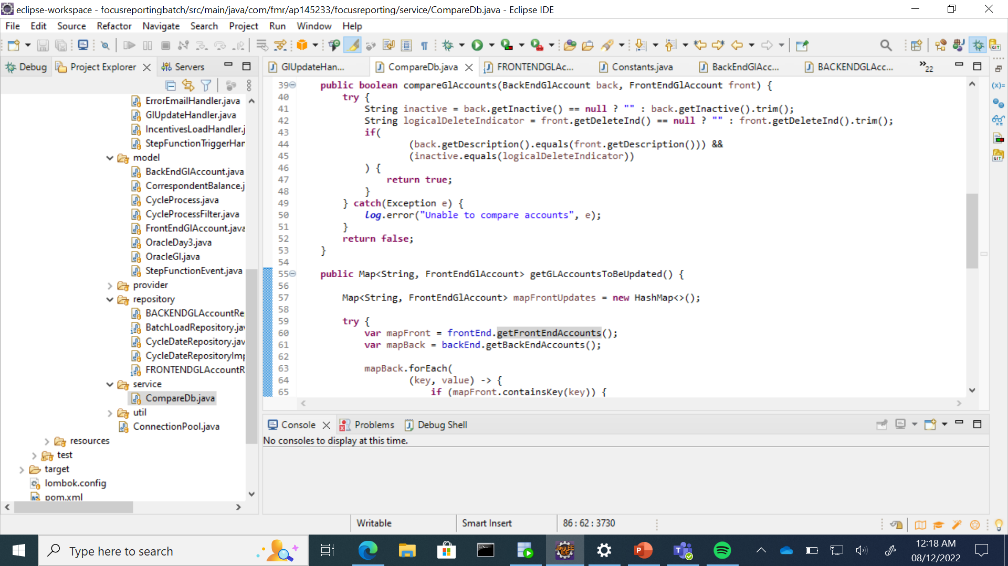

Slide 7
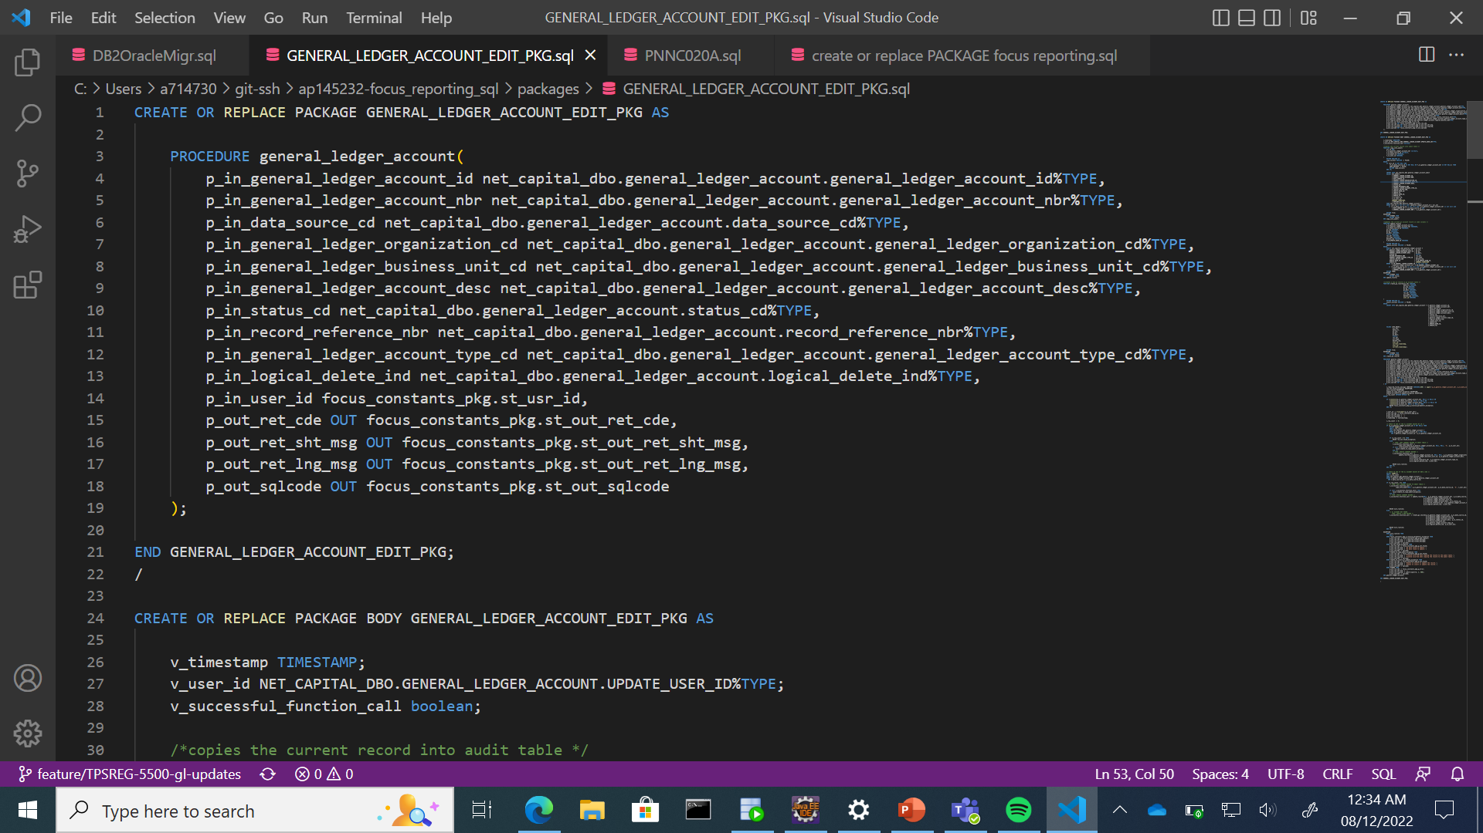

Slide 8
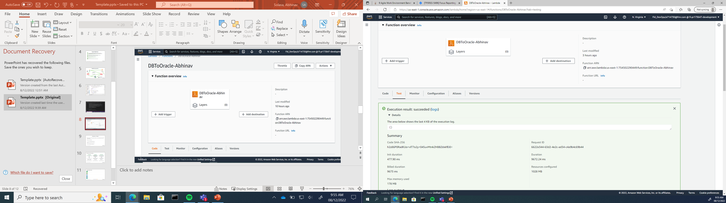

Slide 9
Reflection on Project
Synchronization of data between databases is now completely automated → time efficiency
Sharpened Java Skills
Increased knowledge of Databases
SQL Stored procedure experience
Amazon Web Services Exposure

Slide 10
Summary of Learnings
Technology |  | Team Skills |  | Fun Activities
Java |  | Teamwork and Brainstorming |  | Ton of Ping Pong
SQL |  | Agile |  | Tiktok
Jira |  | Presentation skills |  | Protein Bars
AWS/Lambda/S3 |  | Networking |  | Cornhole

Slide 11
Thank You TPS Regulators!!

